Slide 1
Civil Asset Forfeiture

Slide 2
What is Forfeiture
Forfeiture is the taking of property (of any kind) by the government without compensation to the owner.
Forfeiture follows a overall two step process:
Seize the property
Conduct legal proceedings against the property for forfeiture

Slide 3
Forfeiture v. Eminent Domain
Eminent Domain
Eminent Domain is the process by which a government seizes property (usually real property, i.e. land) for some “just” compensation.
Eminent Domain is a process of seizing property conducted by civil law, not criminal law.

Slide 4

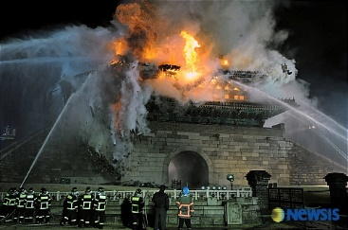
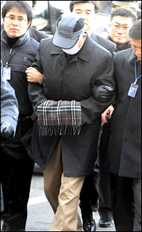
Eminent Domain

Slide 5
Criminal/Civil Forfeiture
Forfeiture can be either criminal of civil:
Criminal: The forfeiting of the assets is associated with, or the result of, a criminal conviction of the defendant.
Civil: A legal fiction that enables law enforcement to take legal action against inanimate objects for participation in alleged criminal activity, whether the owner is guilty or not.
I.E. it is the object itself that is participating in the crime.

Slide 6
Civil Forfeiture
Criminal proceedings are usually against a person (“in personam” jurisdiction). The defendant is the person accused of the crime.
Civil forfeiture actions are called “in rem” proceedings (in rem = “against a thing”). The defendant is the object itself.

Slide 7
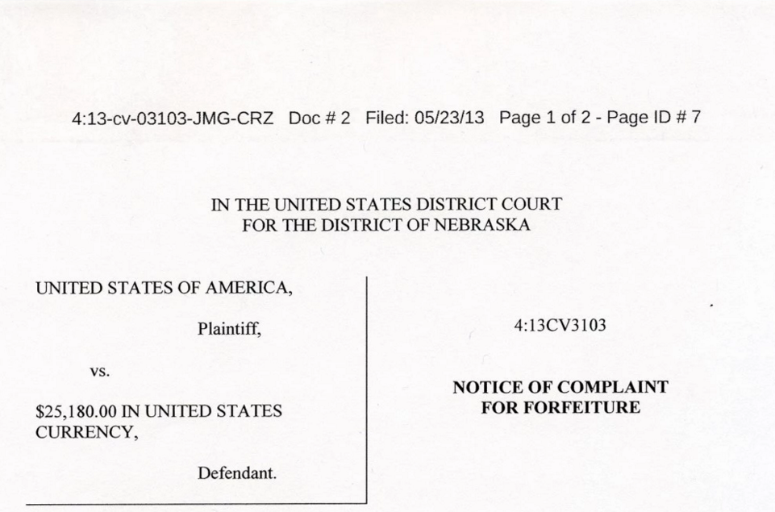
In Rem

Slide 8
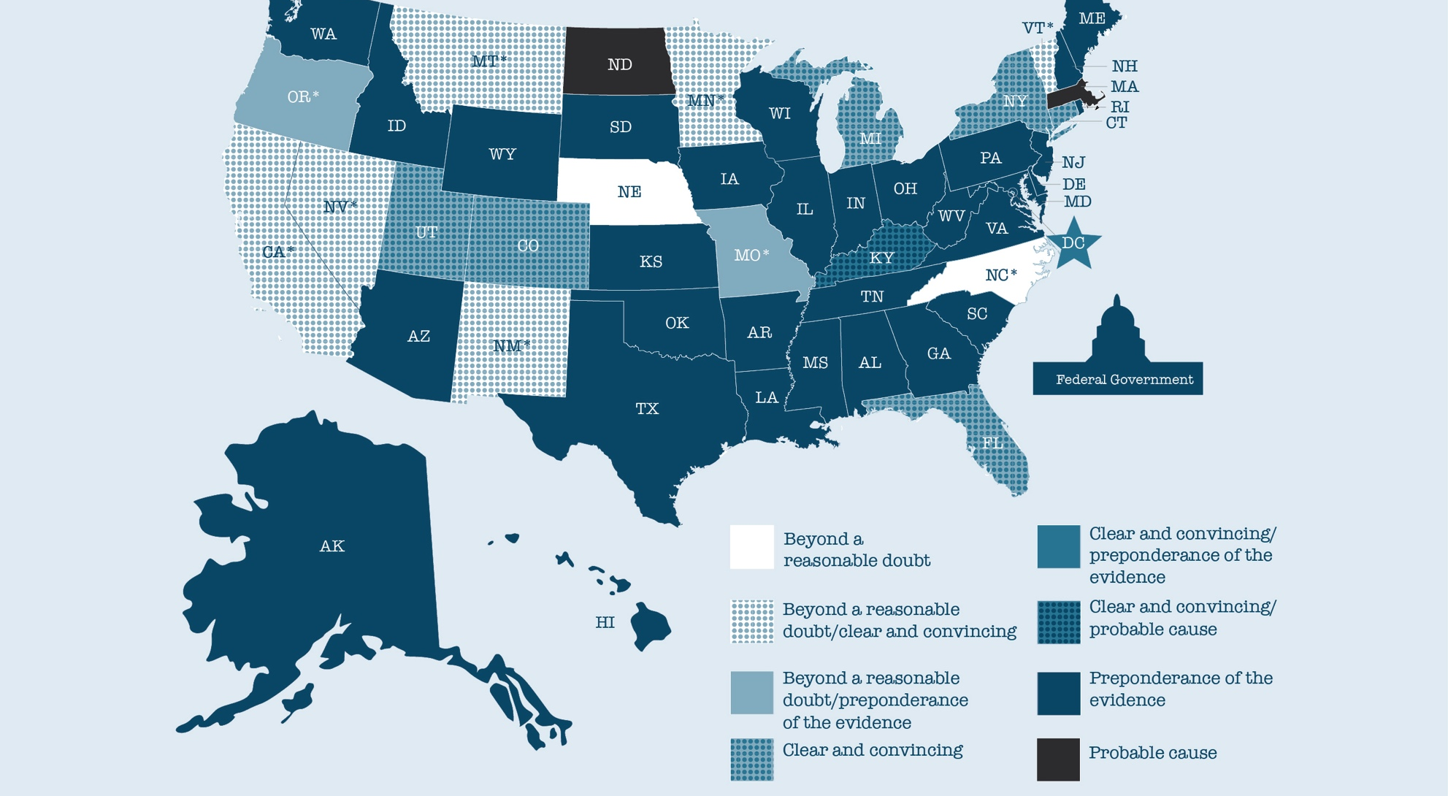
Standard of Proof

Slide 9
Civil Forfeiture
Comprehensive Crime Control Act of 1984
As part of the “war on drugs” Congress passed the CCCA in 1984.
Previously, revenues from CAF went to the government’s general funds.
After CCCA, money earned from property seized by the federal government went to the agency that seized the assets.

Slide 10
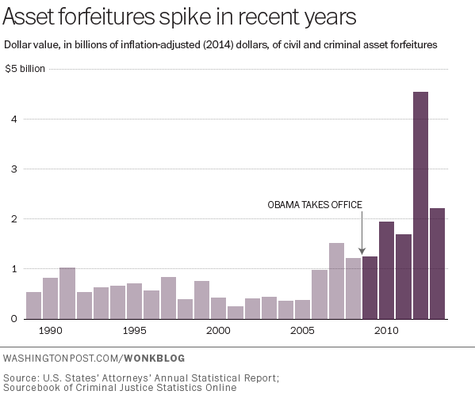

Slide 11
Burden of Proof
Government’s BOP:
Government only has to show the property was used to “facilitate” the alleged criminal activity by “preponderance of the evidence” or sometimes lower standards.
In order to rebut the government’s claim, the OWNER must prove an affirmative defense:
“Innocent Owner Defense” – The owner must show by PotE either i) did not know of criminal activity or ii) upon learning of the conduct, took all reasonable action to stop the use of the property
“Bona-Fide Purchaser” – An innocent purchase of the property who bought the property after the activity was unaware of the connection

Slide 12
CAF – State Usage
Since 1984, State government have also passed CAF laws. However, these laws have been sometimes more restrictive than Federal Law as to where revenues go.
Money is split to general fund or law enforcement agency

Slide 13
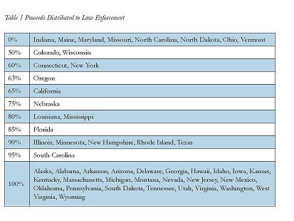
CAF – State Revenues

Slide 14
The End-Around – The Equitable Sharing Program
The Reforms of 2000 included a provision for Municipal/State law enforcement agencies to work with the Federal Government
In Essence, the Local agency would ask the Feds to instituted CAF proceedings in Federal Court under Federal Law (the criminal activity must be illegal under federal law). “Adopted” by the Ferderal agency.
In return, the Federal Government would give up to 80% of the revenues generated back to the local law enforcement agency (NOT the state/local government)

Slide 15
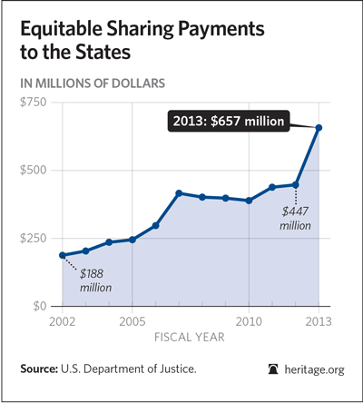

Slide 16
Case Example -
Contemporary Art Institute of Detroit held a “Funk Night” in 2008, attended by about 130 people.
Police came and seized all of the cars of the participants because….
The Institute failed to get a permit to serve alcohol.
http://dailysignal.com//2013/10/28/the-motor-city-wants-your-car-back-civil-forfeiture-in-detroit/

Slide 17
Reforms…?
December 2015 – Department of Justice suspended the equitable sharing program.
Real reason? The program’s budget was cut by Congress…

Slide 18

Reforms?
2017 - New President (and New Attorney General)
Reinstated the Federal
Adoption Program

Slide 19
https://www.youtube.com/watch?v=3kEpZWGgJks

